Slide 1

University of Stirling: Embedding equality and diversity in the curriculum - intercultural encounters
Dr Catriona Cunningham
Academic Development

Slide 2
Aims of workshop
In this session, participants will have the opportunity to:
Critically reflect on the role of interculturalism in learning and teaching in higher education
Consider the impact on equality and diversity
Explore what interculturalism means for you

Slide 3
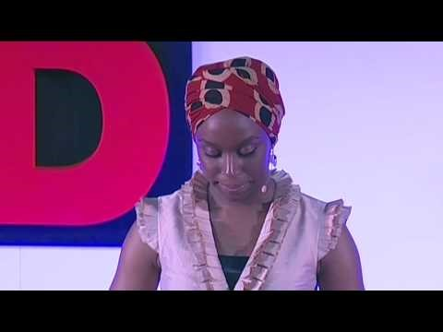
The danger of a single story

Slide 4
By ‘intercultural dialogue’ we mean the ways in which we facilitate, and work towards, understanding and valuing different cultural perspectives. In an academic context, this means taking the time and opportunity to understand and support others’ previous experiences of education, especially when this has been different from the present situation. While this has an obvious relevance to people coming from other countries, it is also a useful way to think about anyone working or studying in Higher Education for the first time.
(Dunford & Grimwood, 2015)

Slide 5
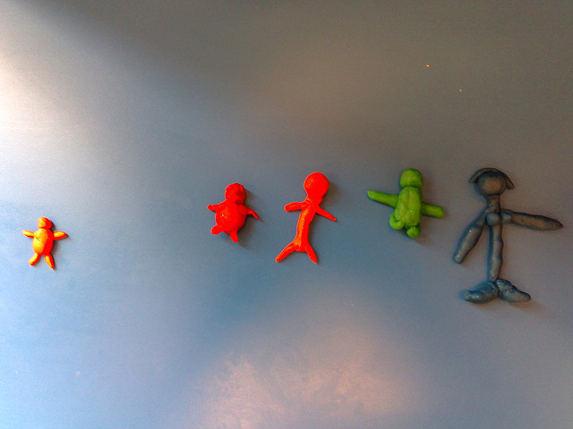
A common problem to all institutions is that they do not allow differences in interaction because all unknown and unexpected differences are disturbing elements to the institutional procedures. Diversity that cannot be assimilated to the frame of reference is perceived as disturbing to the institutional routines.
(Otten, 2003: 16)
Image @ Flikr, Walker, 2007

Slide 6
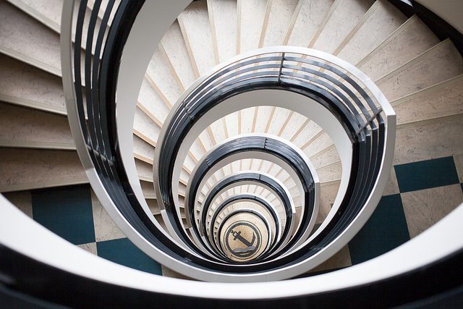
Given the increasing diversity of student and staff communities, it can be argued that the key to successfully internationalising the curriculum, and benefiting from its participants’ diversity, lies first in rejecting existing deficiency models used to frame both international student assimilation and widening participation, and second, in understanding the interconnectedness of home and international students’ multiple identities, positionings and needs.
(Ippolito, 2007: 752)
Image @ Flikr, .naut. 2015

Slide 7
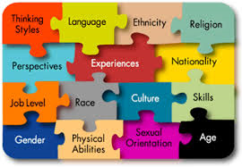
What is diversity?

Slide 8
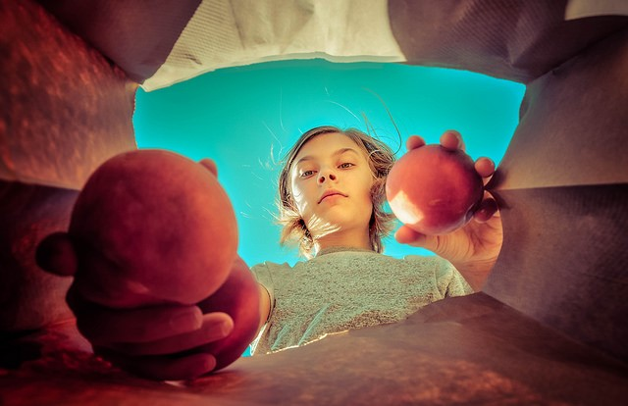
HEA-Embedding Equality and Diversity in the Curriculum project 2016-17: Embedding interculturalism in learning and teaching at Stirling
Image@ Flikr, Jason Ogden, 2016

Slide 9
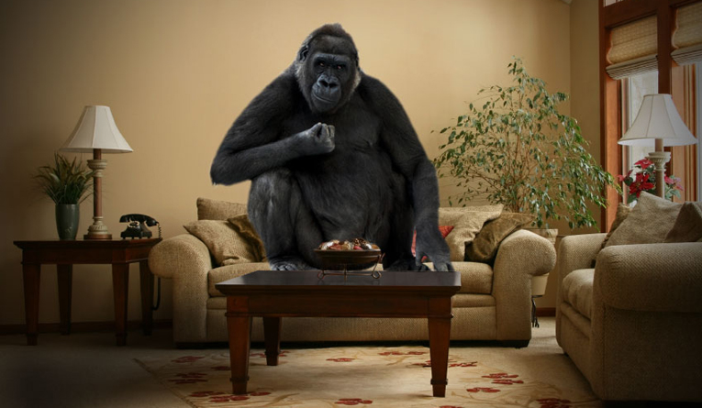
Activities
Intercultural dialogue tool
https://www.heacademy.ac.uk/resource/strategic-enhancement-programme-internationalising-curriculum-toolkit
Commonwealth poem

Slide 10
References
Dunne, C. (2011) Developing an intercultural curriculum within the context of the internationalisation of higher education: terminology, typologies and power, Higher Education Research & Development, 30:5, 609-622.
Ippolito, K. (2007). “Promoting intercultural learning in a multicultural university: ideals and realities”. Teaching in Higher Education 12 (5&6) pp. 749-763.
Kaplan, A. (1993). French Lessons – A Memoir. Chicago and London: Chicago University Press.
MacKinnon, D., & Manathunga, C. (2003) ‘Going global with assessment: what to do when the dominant culture's literacy drives assessment’, Higher Education Research and Development, Vol. 22
Otten, M. (2003) ‘Intercultural learning and diversity in higher education’, Journal of Studies in International Education, Vol. 7, No. 1, pp. 12-26.
Volet, S.E.and Ang, G. (2012). Culturally mixed groups on international campuses: an opportunity for inter-cultural learning. Higher Education Research & Development, 31(1), 21-37. (A re-issue from HERD, 1998, 17(1), 5-23.)

