Slide 1
Inspiring Women in Stem and Beyond
Angela Alexander NUS Scotland Women’s Officer

Slide 2
Background
Identified low number of women in certain subjects at Ayrshire college:
Aeronautical engineering
Motor mechanics
Construction
Computer related subjects

Slide 3
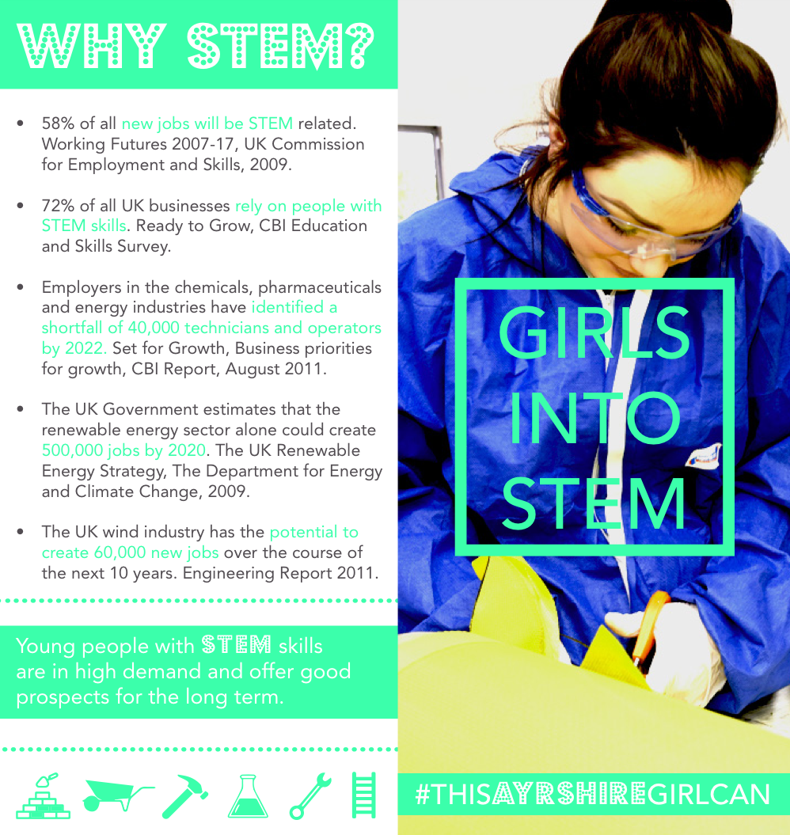

Slide 4
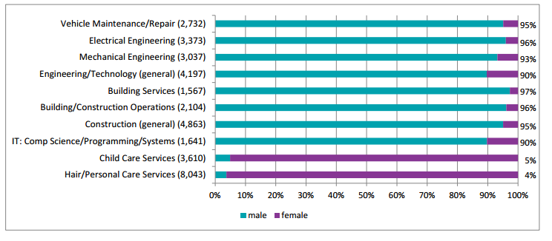
The National Picture
The SFC’s Gender Action Plan
Graph: Scottish Funding Council’s Interim Gender Action Plan, Feb 2016. page 19, available here.

Slide 5
Barriers
Underrepresentation creates underrepresentation
Breaking the cycle

Slide 7
Approach
Social media #ThisAyrshireGirlCan
Employer network events
Video

Slide 9
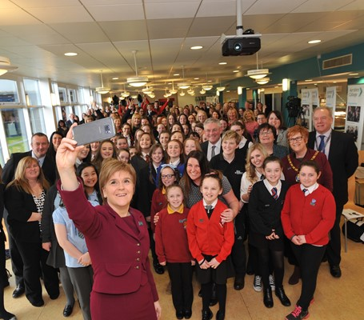
Impact
Image: Skills Development Scotland

Slide 10
Where next?

Slide 11
#InspireHerFuture

Slide 12
Continuing the principles of #ThisAyrshireGirlCan
Sharing stories
Student led
Replication

Slide 13
Evolution
Gender action plan
Work with more organisations
Look beyond STEM, and even beyond subjects

Slide 14
Other considerations
National barriers
Student support (mainstreaming)

Slide 15
What can you do?
Signposting national agencies and organisations
Work with your students association
Identify the courses with the highest gender imbalance on your campus

Slide 16
Over to you
Any questions?
What can you do in your role to address gender imbalance nationally, or locally?

