Slide 1
Trans.Edu Scotland
Investigating the experiences of and support for trans applicants, students and staff in Scottish colleges and universities
Dr. Matson Lawrence, Research Associate
University of Strathclyde

Slide 2
About the project
Delivered by the Equality & Diversity and Widening Access Teams at the University of Strathclyde
Funded by the Scottish Funding Council
One year project, until late June 2017
Investigating the experiences of and support for trans applicants, students and staff in the Scottish HE and FE sectors.

Slide 3
Why this area?
Evidence to suggest that trans people face significant levels of harassment and bullying – including within education.
Increasing recognition within the HE and FE sectors of the potential challenges and barriers trans people face.
Existing evidence base for England and Wales (ECU 2009).
Current lack of information and empirical evidence to assist Scottish institutions in meeting statutory and ethical responsibilities.

Slide 4
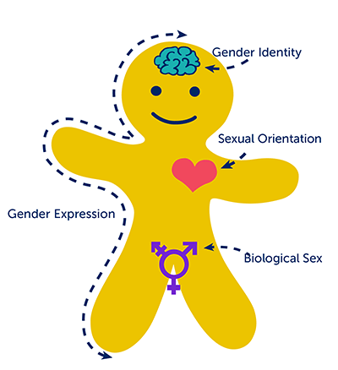
A brief tour of terms
Gender / Gender identity: A person’s sense of their gender, which may be female, male, or neither.
Sex: A person’s physical and biological sex characteristics.
Gender expression: How a person outwardly expresses their gender.
Sexual orientation: The gender(s) a person is sexually and/or romantically attracted to.

Slide 5
A brief tour of terms
Trans: Umbrella term to describe a range of genders / gender identities that differ from the sex and gender assigned to an individual at birth.
Trans identities and experiences can include:
  Transsexual
  Trans / Transgender
  Gender variant
  Genderqueer, non-binary, genderfluid, agender, etc.
  …and those who have a trans(gender/sexual) experience or history.

Slide 6
A brief tour of terms
Title: How we formally address someone, e.g.
  Ms, Dr, Mrs, Mr,
  Mx or no title.
Pronouns: How we refer to someone, e.g.
  She/Her/Hers,
  He/Him/His,
  They/Them/Theirs,
  Sometimes other pronouns.
Any questions?

Slide 7
Research questions
What barriers are faced by trans people in the Scottish FE and HE sectors?
  What are the barriers faced by trans applicants in gaining access to further and/or higher education?
  What are the barriers faced by trans students in further and/or higher education?
  What are the barriers faced by trans staff in the Scottish FE and HE sectors?
What are the support needs of trans applicants, students and staff in Scottish FE and HE institutions?
What monitoring practices and support protocols pertaining to trans people do Scottish FE and HE institutions currently have in place?

Slide 8
Project outline
There are three key stages to the project:
Documentary analysis and mapping of current practice within Scottish HEIs and colleges.
Empirical research investigating the experiences of trans applicants, students and staff.
Development of practical toolkits and case studies to empower institutions to develop their policies and activities, alongside a peer support Community of Practice.

Slide 9
Research remit
Trans identified…
Prospective or current applicants
Current or recent students
Prospective, current or recent staff

Slide 10
Research remit
Sector Staff & Reps
Equality & Diversity, HR, Student Services etc.
Staff with experience of supporting trans students / staff
Staff and student union representatives

Slide 11
Intersectionality
Intersectionality refers to the intersections of identity and experience
In practice, this can mean that an individual has more than one protected characteristic or marginalised identity / experience

Slide 12
Intersectionality
For example:
  a student who is trans, minority ethnic and bisexual
  an applicant who is gay, disabled and a care-leaver
These identities and experiences intersect to create multiple and intersecting barriers and oppressions
Important to centre this when considering and conducting research concerning a protected characteristic

Slide 13
Potential barriers
Teaching, learning and assessments
Accommodation
Sports and leisure services
Health and medical services
Graduation and parchment services
Counselling and pastoral services
Internships / Careers
UCAS
Application forms
Qualifications
Identification documents
International opportunities

Slide 14
What we will deliver
Practical toolkits, including templates, guidance, and audit tools for use by institutions
Case studies to champion best practice in the sector
Full report of research findings
Community of Practice for practitioners

Slide 15
How you can get involved
Take part in the research via surveys & interviews
  Trans-identified applicants, students and staff
  Sector staff within Equality & Diversity, HR, Student Services etc.
  Sector staff who have experience of supporting trans applicants, students and staff
Share project information with your colleagues & networks
Keep in touch via the contact details on your handout

