Slide 1
Tackling Gender Imbalance
Rhona McComiskie and Kaisa Macdonald

Slide 2
IMPACT FOR ACCESS
Background
Approach
Gender distribution at RGU
Research & Activity
Partnerships & Support
Findings & Recommendations
Next Steps

Slide 3
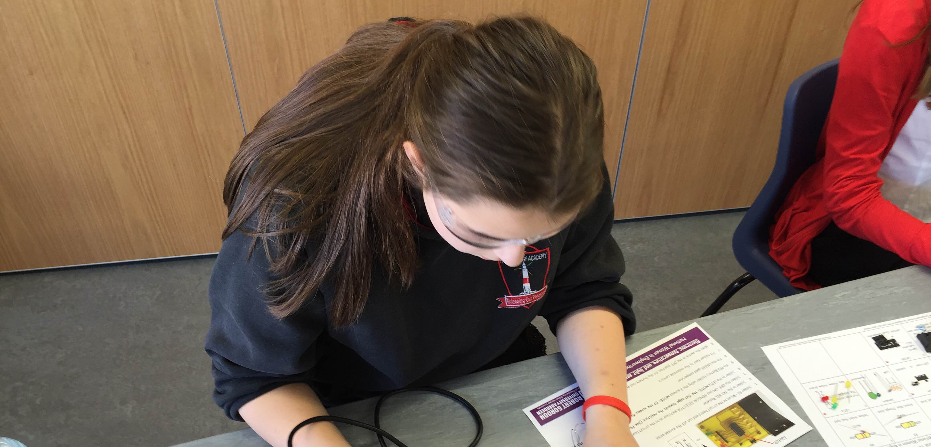
BACKGROUND
“Too many young people continue to make choices which conform to gender stereotypes which in turn limit their longer term career opportunities.”
-DYW Commision
Notes:
We need to counter the influence of early culture and prejudice to better enable young people to make choices which are right for them in the long term.

Slide 4
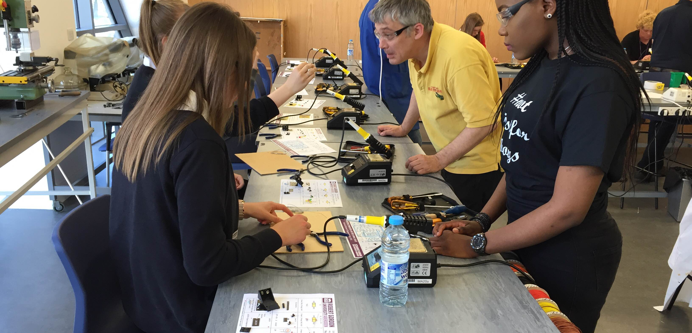
BACKGROUND
“Greater collaboration between our institutions and schools, with a focus on tackling gender imbalances at all stages of the learner journey.”
-SFC Gender Action Plan
Notes:
We need to counter the influence of early culture and prejudice to better enable young people to make choices which are right for them in the long term.

Slide 5
APPROACH
Research Expose and better understand the challenges around gender segregation among the most affected subject areas
Partnership Establish a partnership in the North East region to tackle the issue of gender imbalances
Activity Develop project work in response to the challenges identified, with a focus on early engagement in schools and pathway provision to encourage and support diverse participation across gender
Support Provide support mechanisms for current students enrolled on male/female dominated programmes

Slide 6
GENDER DISTRIBUTION AT RGU: UG POPULATION
Notes:
RGU has a longstanding gender imbalance, with females comprising over 60% of its undergraduate population.
Further analysis highlights a differentiated pattern across schools.
In particular, more than 80% of Nursing and Midwifery and Applied Social Studies students are female, while more than 80% of Engineering and Computing Science and Digital Media students are male.
Data source
From 'EM-student no check for enr mont 2 RW' - 2015/16 data

Slide 7
GENDER DISTRIBUTION AT RGU: UG POPULATION
Current UG Population (June 2016)
Notes:
Further analysis highlights a differentiated pattern across schools.
In particular, more than 80% of Nursing and Midwifery and Applied Social Studies students are female, while more than 80% of Engineering and Computing Science and Digital Media students are male.
When we look in more detail at the populations in these subject areas, it’s clear that these patterns are persistent.
Data source
From 'EM-student no check for enr mont 2 RW' - 2015/16 data

Slide 8
GENDER DISTRIBUTION AT RGU: UG APPLICANTS
Notes:
The gender imbalance at RGU is evident from application, with proportions of male and female applicants exactly echoing those of the student population.
Further analysis highlights a differentiated pattern across schools.
In particular, more than 80% of Nursing and Midwifery and Applied Social Studies students are female, while more than 80% of Engineering and Computing Science and Digital Media students are male.
Data source
From 'EM-student no check for enr mont 2 RW' - 2015/16 data

Slide 9
GENDER DISTRIBUTION AT RGU: UG APPLICANTS
2015/16 Entry
Notes:
The applicant population is very similar to the undergraduate population, with the percentage of female applicants consistently higher than the percentage of male applicants in Applied Social Studies and Nursing and Midwifery, and the percentage of male applicants heavily outweighing the percentage of female applicants in Computing and Engineering.
This trend has been consistent over the last six years, with minor fluctuations from year to year.
Patterns identified at point of application are generally reflected at point of enrolment, although the gap has steadily widened in Engineering over the last three years, from 89% to 95% male entrants, despite the percentage of male applicants remaining stable.
Data source
Applicants (NB not applications) - WA Applicant Status 2016 - Conditions kept: Course Code LIKE U%, Attend Code NOT IN (12,13,44,51,63,64) (not Erasmus, dormant, writing up, on sabbatical) Data for 2015/16 entry.

Slide 10
GENDER DISTRIBUTION AT RGU: MEASURES OF SUCCESS
Satisfaction (SEQ) Student Achievement Rates
Notes:
Overall satisfaction, as measured by the Student Experience Questionnaire, is higher among males in Applied Social Studies, and among females in Computing, despite these schools having lower intake of these genders. Engineering and Nursing show even levels of satisfaction across genders.
Achievement rates (the proportion of students receiving an award or progressing to the next stage) are higher among females in Nursing and Applied Social Studies. Despite the gap in the proportion of male and female entrants, female achievement is also higher in Engineering. In 2014/15 Computing was the only subject in which males outperformed females, albeit by only 2 percentage points.
Data sources
2014-15 SEQ Report 1 (overall satisfaction) – “Overall, I was satisfied with the quality of my course” (% agree); all stages.
2014-15 SARs Full-Time UG - Overall success rate.

Slide 11
GENDER DISTRIBUTION AT RGU: MEASURES OF SUCCESS
Positive Destinations
Notes:
The proportion of males and females achieving a 1st/2:1 is variable, with a higher percentage of females often achieving these classifications in Computing, and a higher percentage of males in Applied Social Sciences. Important to note that some of these schools have low numbers of male/female graduating Honours students and therefore proportions are easily skewed by one or two students.
Despite differences in the schools' gender composition, male and female alumni from Nursing, Applied Social Studies and Engineering show similar patterns in the last three years in terms of their onward destinations. A higher proportion of male respondents who had completed Computing degrees were in employment or further education, although the previous two surveys found a trend in the opposite direction.
Data sources
2014-15 1st/2:1 Achievement - 2014-15 Honours Classifications for EDAG
Destinations of Leavers (year of leaving 2013/14) - Graduate Employment Destinations Survey 2011_12 2012_13 and 2013_14 (Worksheet: HESA Employment Indicator), FT & PT combined, First Degree, UK domiciled.

Slide 12
RESEARCH
What is required to tackle gender imbalance at subject level?
Focus groups with pupils and teachers exploring
Factors influencing the choices
Key stages along the learner journey
Support and activities providing maximum impact
STEM questionnaire to research pupils’ attitudes toward STEM subjects and careers
Notes:
Based on Ruth’s findings it was clear that the gender imbalance is present at the point of application.
-> girls not applying to Engineering and Computing courses and boys not applying to Nursing and Midwifery courses -> Identified a need to further investigate the issues along the pipeline to better understand when and why the gender imbalance emerges and what could be done to influence the choices
Organised 8 focus groups. The main aim to explore three areas.
What factors influence the subject and career choices in female and male dominated subject areas. Who are the key influencers? What are the barriers when the pupils make their choices?
What are the key stages along the learner journey. When does the gender imbalance emerge? When would be the best time for interventions?
What kind of support or activities would provide the maximum impact. What is already done? What has been successful? What could be done in future?
Delivered focus groups with S1-S6 pupils attending our partner schools. In one focus group two currents students attending, one female student form Engineering and one from Computing.
In the first 4 focus groups explored gender stereotypes in relation to career choice.
Based on the first focus groups identified subject choice as a key stage where gender imbalance first emerges -> Organised further 4 focus groups to specifically explore the influence of gender on subject choice.
In addition to the focus groups with pupils one focus group was organised with 15 teachers to explore the teachers’ views on what they consider to be the key influences impacting on subject choice.

Slide 13
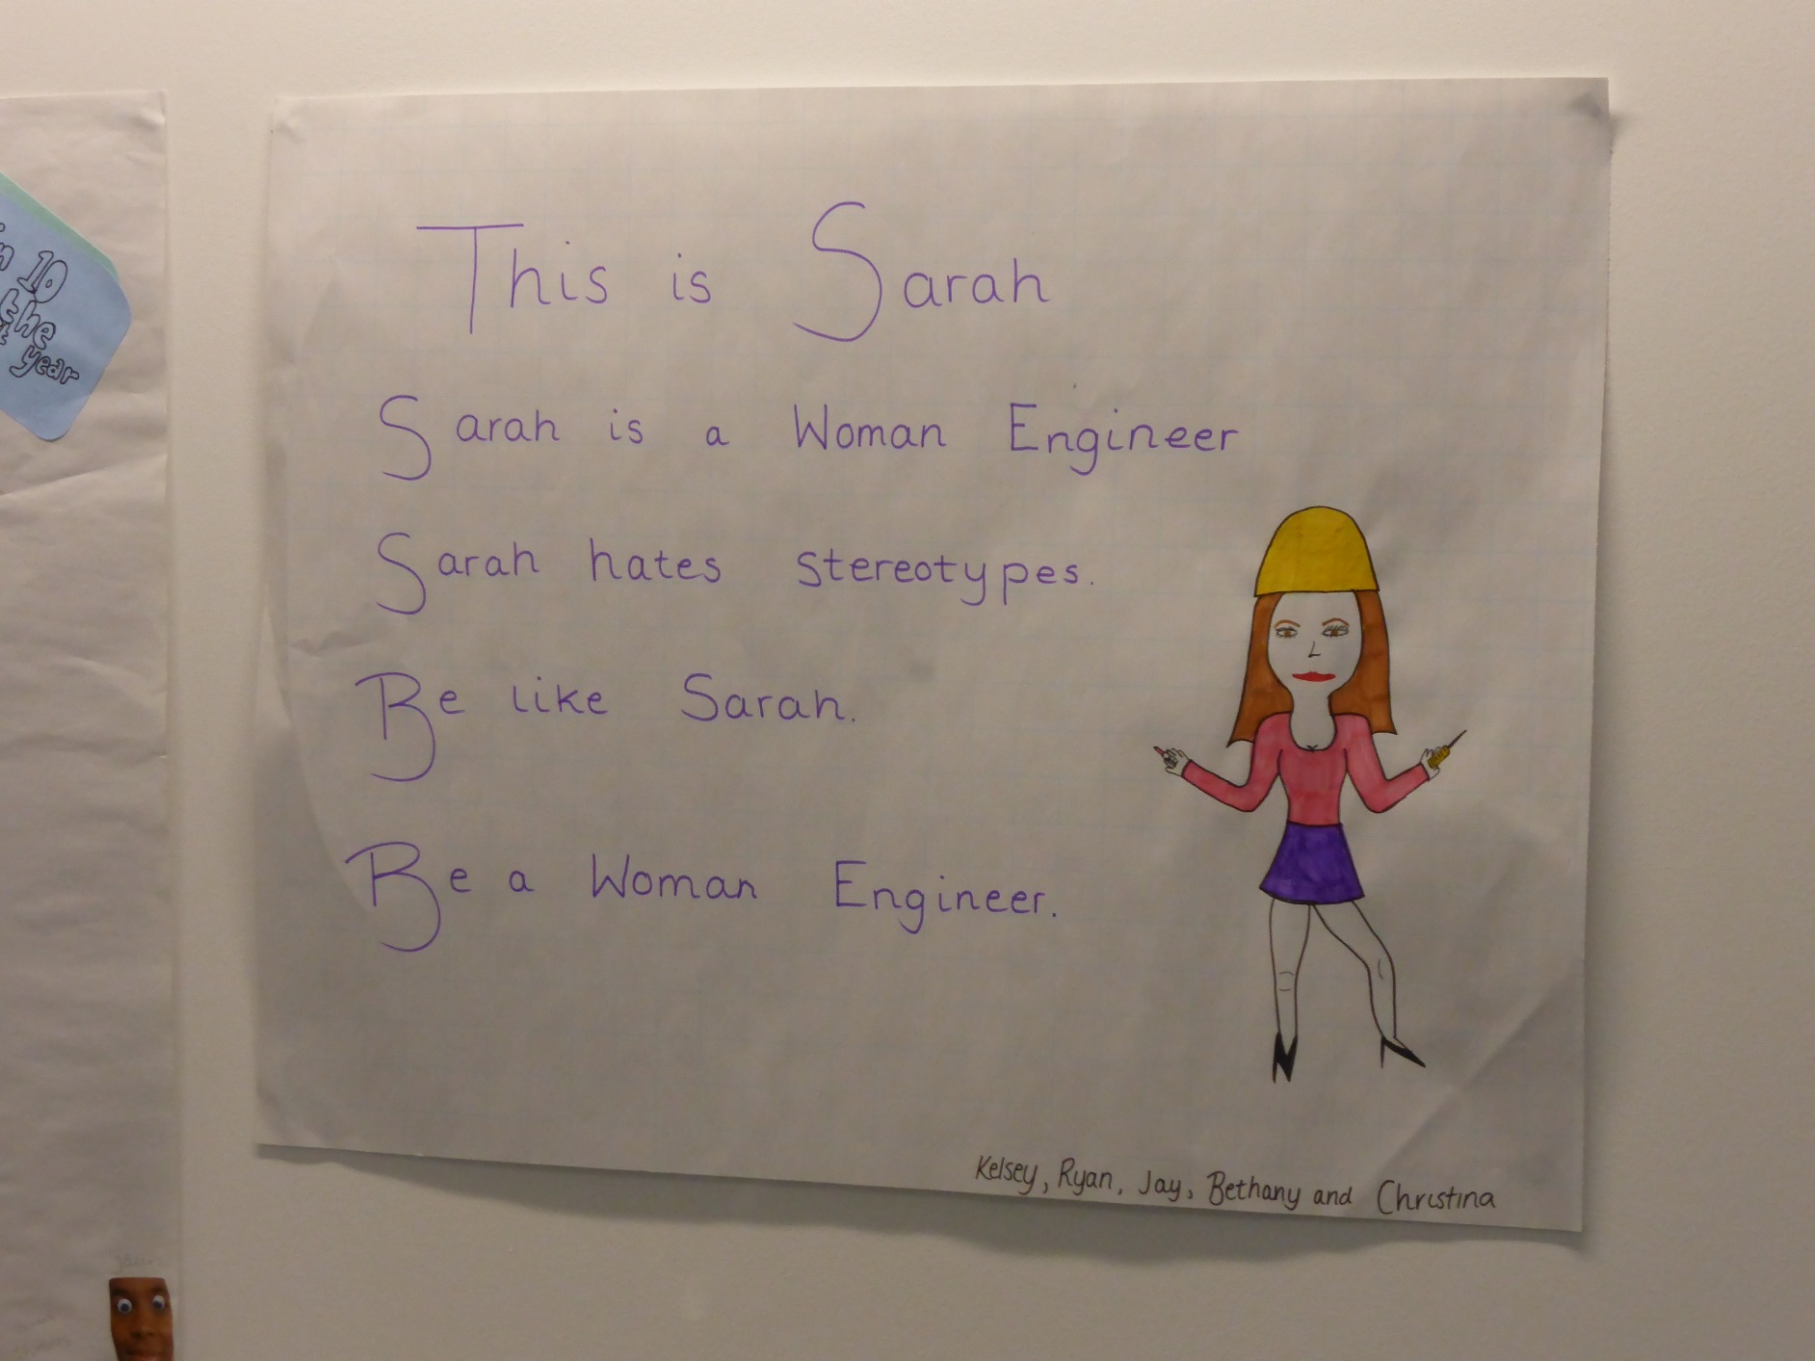
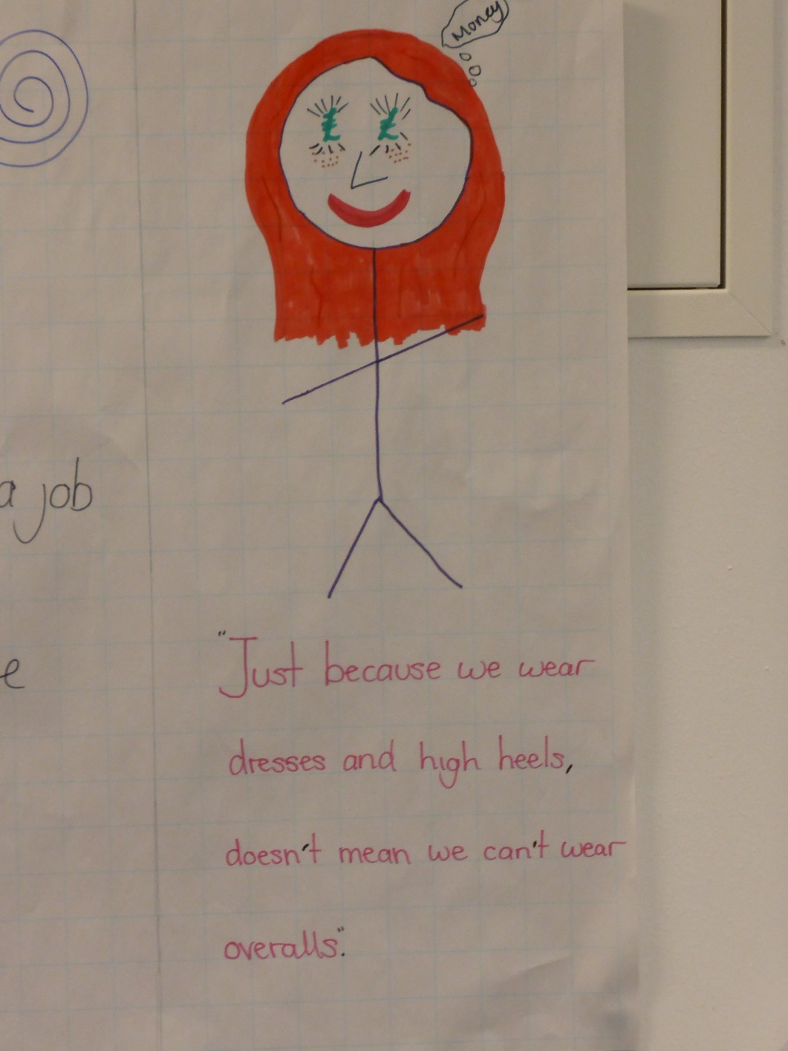
ACTIVITY
Embedding gender as a focus of WP activity
Aligning work with national campaigns
NWED (S3)
British Science Week (S1-S3)
Piloting lesson plans
Developing a package of lesson plans and teacher CPD

Slide 14
KEY FINDINGS
Subject choice as a key stage
Importance of an early intervention
“If something could be done in S2-S4 when they lose ‘I’ll give this a shot, I’m willing to put myself out there.”
Unconscious gender stereotyping
Visibility and lack of role models
“It would make a difference if you are encouraged by someone who has had similar experiences and has empathy for your situation.”
Notes:
Based on the focus group findings -> identified subject choice as a key stage where the gender imbalance first emerges. -> The pupils see girls choosing different subjects to boys. In the class rooms they can see a clear majority of one gender. They start to feel the pressure to choose subjects which are considered more suitable for their own gender.
It seemed that traditional views of gender and clear distinctions between male and female roles still prevail amongst pupils -> Nurturing and caring roles more suitable to females and the technical and “messy” engineering jobs more suited for men.
However, when asked why Nursing is more suitable for girls or Engineering for boys the pupils found it hard to explain the reasons why this is the case -> Gender stereotyping occurred in unconscious level rather than conscious level. In the conscious level they seemed to think that everybody is equally capable to study the subjects or work in these professions but in the unconscious level they still considered specific school subjects or careers more suited to one gender.
The perceptions of different careers were based on what they see around them at home, in school or when they encounter people working in different professions. They mainly see female nurses -> they think that Nursing is for women or they mainly see male joiners -> those jobs are for men.
In terms of influencers identified two key influencers.
Family members influence significantly pupils’ subject and career choices -> decisions based on what they see and hear at home and advise and encouragement from parents, siblings and grandparents influence pupils’ choices. If a pupil chooses a non-traditional subject area -> mothers encouraging their sons into health care professions, fathers encouraging their daughters into engineering
Peers influence the subject and career choice. Peer pressure and the strong desire to be part of the group steers pupils’ decisions towards traditional choices -> girls choose “girls’ subjects” like Home Economics, Biology and English and boys choose “boys’ subjects” like PE, Physics and Computing. Few examples of comments. -> traditional roles of women in the kitchen and men working and how the pupils pressure each other to choose subjects that are more suited to their gender.

Slide 15
KEY FINDINGS
Key influencers
Family members
Peers
“Why don’t you choose Biology, there are more girls there.”
“Why do you take physics? It’s hard, it’s for boys.”
One off interventions have little impact on subject choice “We’ve done a lot of activities around girls into STEM but its not translating… They seem to enjoy it but when it comes to choosing subjects it’s not translating.”
Notes:
Based on the focus group findings -> identified subject choice as a key stage where the gender imbalance first emerges. -> The pupils see girls choosing different subjects to boys. In the class rooms they can see a clear majority of one gender. They start to feel the pressure to choose subjects which are considered more suitable for their own gender.
It seemed that traditional views of gender and clear distinctions between male and female roles still prevail amongst pupils -> Nurturing and caring roles more suitable to females and the technical and “messy” engineering jobs more suited for men.
However, when asked why Nursing is more suitable for girls or Engineering for boys the pupils found it hard to explain the reasons why this is the case -> Gender stereotyping occurred in unconscious level rather than conscious level. In the conscious level they seemed to think that everybody is equally capable to study the subjects or work in these professions but in the unconscious level they still considered specific school subjects or careers more suited to one gender.
The perceptions of different careers were based on what they see around them at home, in school or when they encounter people working in different professions. They mainly see female nurses -> they think that Nursing is for women or they mainly see male joiners -> those jobs are for men.
In terms of influencers identified two key influencers.
Family members influence significantly pupils’ subject and career choices -> decisions based on what they see and hear at home and advise and encouragement from parents, siblings and grandparents influence pupils’ choices. If a pupil chooses a non-traditional subject area -> mothers encouraging their sons into health care professions, fathers encouraging their daughters into engineering
Peers influence the subject and career choice. Peer pressure and the strong desire to be part of the group steers pupils’ decisions towards traditional choices -> girls choose “girls’ subjects” like Home Economics, Biology and English and boys choose “boys’ subjects” like PE, Physics and Computing. Few examples of comments. -> traditional roles of women in the kitchen and men working and how the pupils pressure each other to choose subjects that are more suited to their gender.

Slide 16
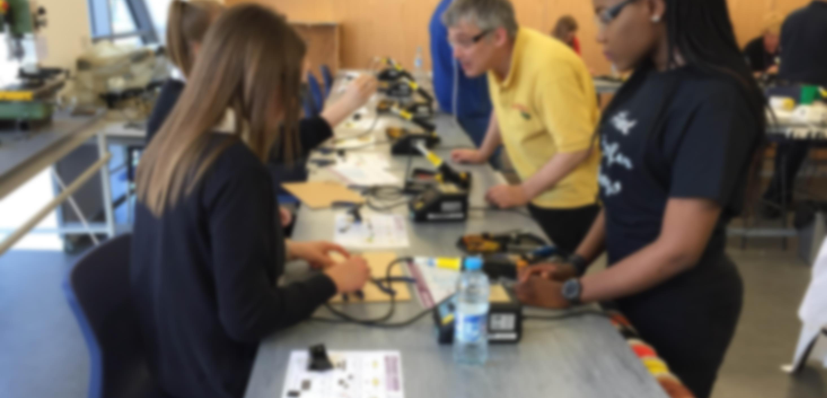
PARTNERSHIPS
Development of a regional partnership to address, tackle and monitor gender imbalance
Worked closely with ACCESS RGU’s partner schools
Regional event to share findings and exchange knowledge
Formed a regional working group
Developed a regional mapping tool
Secured ongoing commitment to developing a collaborative approach

Slide 17
SUPPORT
Developing support mechanisms
Improving the student experience
Engaging academics
Connecting our students
Enhancing student involvement
Student Ambassadors
RGU Union
Student Intern

Slide 18
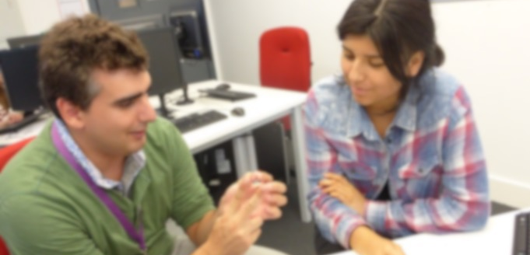
RECOMMENDATIONS
Develop an engagement strategy, with schools as partners, to tackle gender imbalance from an early age.
Embed an approach to tackling gender imbalance across all widening participation activity and prioritise gender equality in wider access strategy.
Create regional partnerships to work jointly to tackle gender imbalance at a local level, maximising the effective use of resources and developing coherent pathways for learners.
Notes:
Based on our findings –> recommendations for activities and support to address the imbalance.
Start at an early age prior to subject choice. -> The interventions have a greater impact if they starts at an early age before the young people form fixed ideas of different subjects and professions.
Should influence the influencers. -> Perceptions formed through early socialisation processes and to influence the young peoples’ choices you need to influence perceptions of the people who socialise with the young person.
Be sustained over longer period of time because -> One-off interventions seem to have little impact on choices -> should aim for a pipeline approach where we deliver multiple interventions over longer period of time.
Be embedded in the core activities ensuring that we take the gender aspect into account in everything we do.
Based on our recommendations:
Agreed with our partner schools to deliver sessions with S2 pupils prior to subject choice focusing on challenging gender stereotypes in relation to subject choice
Developing materials and piloting workshops with S4-S6 focusing on unconscious bias
Developing a resource pack for the teachers to use in PSE classes
Looking at our existing on campus activity and encouraging more balanced group through girls or boys only taster sessions
Using national days like Women into Engineering as a means of increasing visibility and encouraging activity and engagement

Slide 19
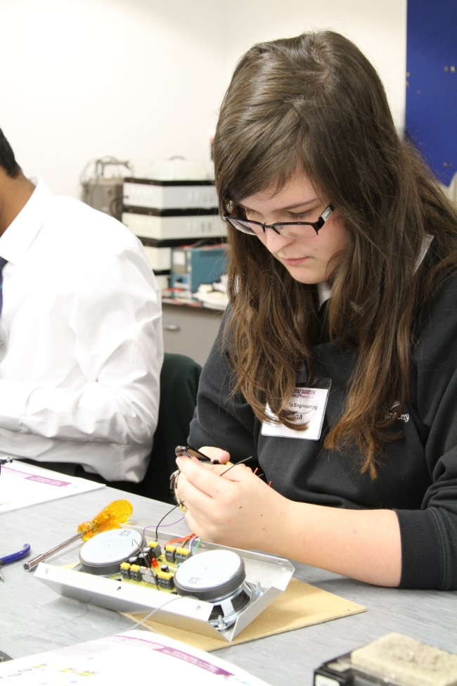
NEXT STEPS - BREAKING THE CYCLE
Attitudes & perceptions
Gender imbalance in subjects at school
Gender imbalance in course uptake at FE/HE
Under
representation in the workplace
Lack of role models
Notes:
Attitudes & perceptions:
Formed early and are formed as a result of early socialisation experiences
Study shows girls are less likely to be interested in a career in science and that interest in science appears to decline from age 11 (some studies suggest this is even earlier)
Relevance to their lives appears to be a key driver influencing whether girls are encouraged into sciences. Links to Physics appear more difficult for girls to identify and this lack of perceived relevance can lead to a decline in interest.
Some STEM subjects are viewed as ‘male’ and perceptions of science are not consistent with girls’ constructions of being feminine
Girls also appear less confident in their abilities with confidence levels decreasing as they get older
At the critical time of subject choice girls are lost to certain careers as choices made at this stage are based on attitudes and perceptions formed in earlier years
At first subject choice stage (SCQF level 3-5) girls are under-represented in all areas of STEM and the gap widens at the next stage (SCQF level 6-7)
(Education Scotland Report/SQA 2014 stats) In 2014, girls represented:
7% of entries for Higher in Technological Studies
20% of entries for Higher Computing
28% of entries for Higher Physics
Under-representation of boys in Biological science
36% of entries for Higher Biology
Gender balance levels have remained largely static for the last 30 years
Higher Education (HESA) 2014 Scottish Undergrad figures:
Computer Studies – 18% women
Engineering – 16% women
73% of women graduates are lost from STEM (compared with 48% of male graduates)
July-Sept2014 – Quarterly Labour Force Survey
Engineering – 5% women
ICT professionals – 22% women

Slide 20
Questions & Discussion

