Slide 1
Studying With Conviction
Dughall Laing
@RWithConviction

Slide 2
Studying With Conviction - The impact of criminal convictions on access to and outcomes from tertiary education.
This interactive workshop will review the
findings of the Studying With Conviction project
and open discussions about providing solutions
for conviction disclosure anxiety through the
student cycle.

Slide 3
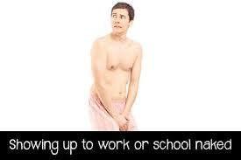
Feeling exposed in unfamiliar environments!

Slide 4
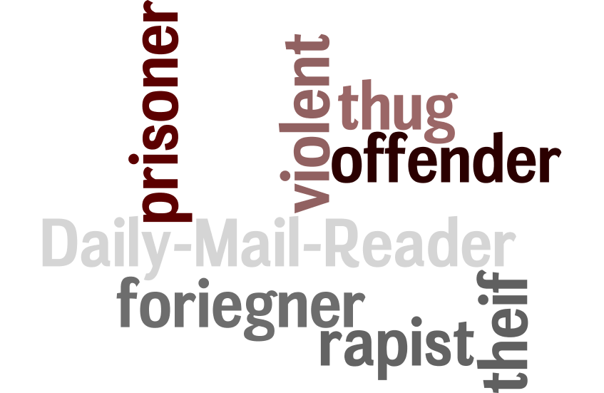

Slide 5
How common are convictions?
Do we harbour conscious or unconscious bias relating to people with convictions and how does that manifest when it is combined with other “different from me” observations such as weight, height, race, gender and other barriers or protected characteristics?
Do people with convictions face discriminatory decisions from employers, insurers, landlords and others?
When a range of decisions go against people with convictions, do they tend to attribute their criminal record as the important factor in this decision?

Slide 6
Discussion
What would best practice look like for the following stages:
Pre-admissions
Admissions

Slide 7
What Escalates and De-escalated Conviction Disclosure Anxiety?

Slide 8
To what extent is there self de-selection by people with convictions due to misconceptions and does this contribute to self selecting stereotypes and avoidance behaviour, self de-selection, lying on application forms and conviction disclosure anxiety?
What rights and responsibilities do people with convictions have to withhold or disclose conviction information in different circumstances?
Do people with convictions know about these rights and responsibilities?

Slide 9
Discussion
What would best practice look like for the following stages:
Student Services
Careers Guidance

Slide 10
How does it feel to be asked about your criminal history?
Is a criminal conviction a reliable risk proxy?
How many students are arrested or convicted while they are studying and what support do they need?

Slide 11
More information
www.recruitwithconviction.org.uk
dughall@recruitwithconviction.org.uk
Notes:
Normal intro
Convictions are the forgotten barrier/characteristic when it comes to employment.
Not to say they are the same but convictions rarely if never come without additional equality barriers.

