Slide 1
Corporate Parenting and You
#ProudCorporateParent

Slide 2
Robert Foster
Corporate Parenting Officer FE/HE

Slide 3
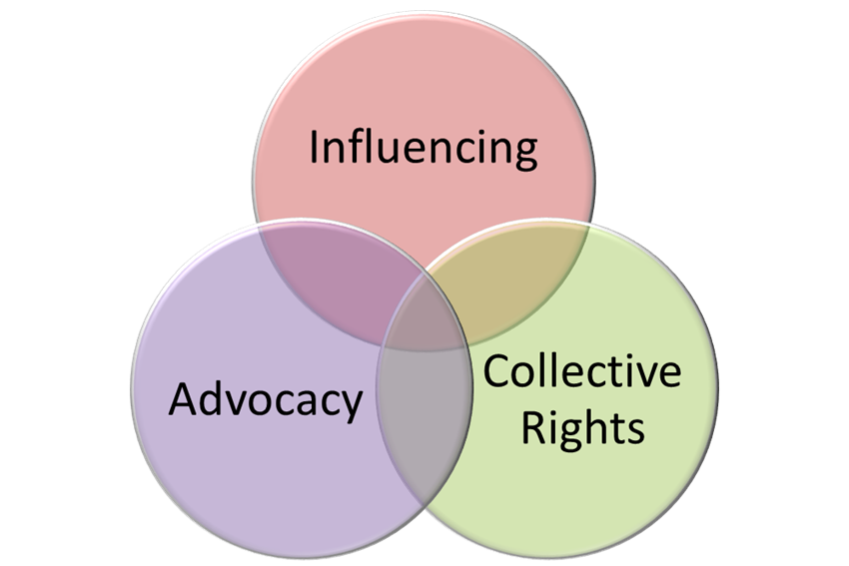
Who are Who Cares? Scotland…?

Slide 4
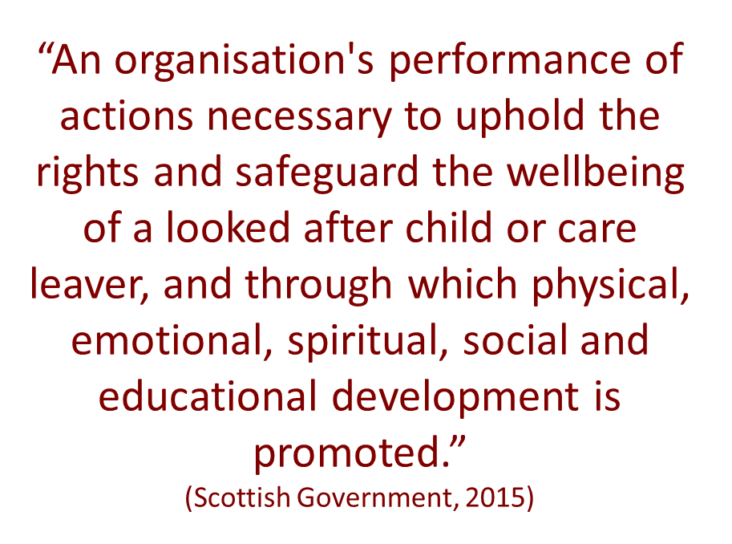
What is Corporate Parenting?

Slide 5
24 Corporate Parents
Scottish Ministers
A local authority
National Convener of Children's Hearings Scotland
Children's Hearings Scotland
Principal Reporter
The Scottish Children’s Reporter Administration
A health board
A board constituted under the National Health Service (Scotland) Act 1978
Healthcare Improvement Scotland
Scottish Qualifications Authority
Skills Development Scotland
Social Care & Social Work Improvement Scotland
The Scottish Social Services Council
Sport Scotland
The Chief Constable of the Police Service of Scotland
Scottish Police Authority
Scottish Fire & Rescue Service
The Scottish Legal Aid Board
Scotland’s Commissioner for Children and Young People
The Mental Welfare Commission for Scotland
The Scottish Housing Regulator
Creative Scotland
A “post-16” education body
Bòrd na Gàidhlig

Slide 6
Project Aims
Equality for Care Experienced Young People
Assist SFC to meet National Ambition for Care Experienced Students
Support Colleges and Universities to meet their duties as Corporate Parents

Slide 7
Our Method
Engage with Senior Managers through level 2 training
Policy support
Students’ Associations
Online Education Hub
The Care Experienced Voice is heard throughout

Slide 8
Becoming Care Experienced
How/When/Why/Where does it happen?

Slide 9
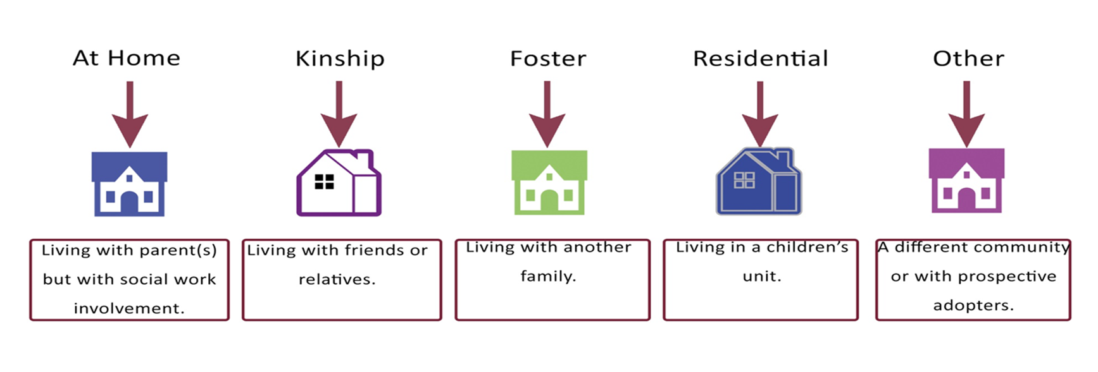
Where is care delivered?

Slide 10
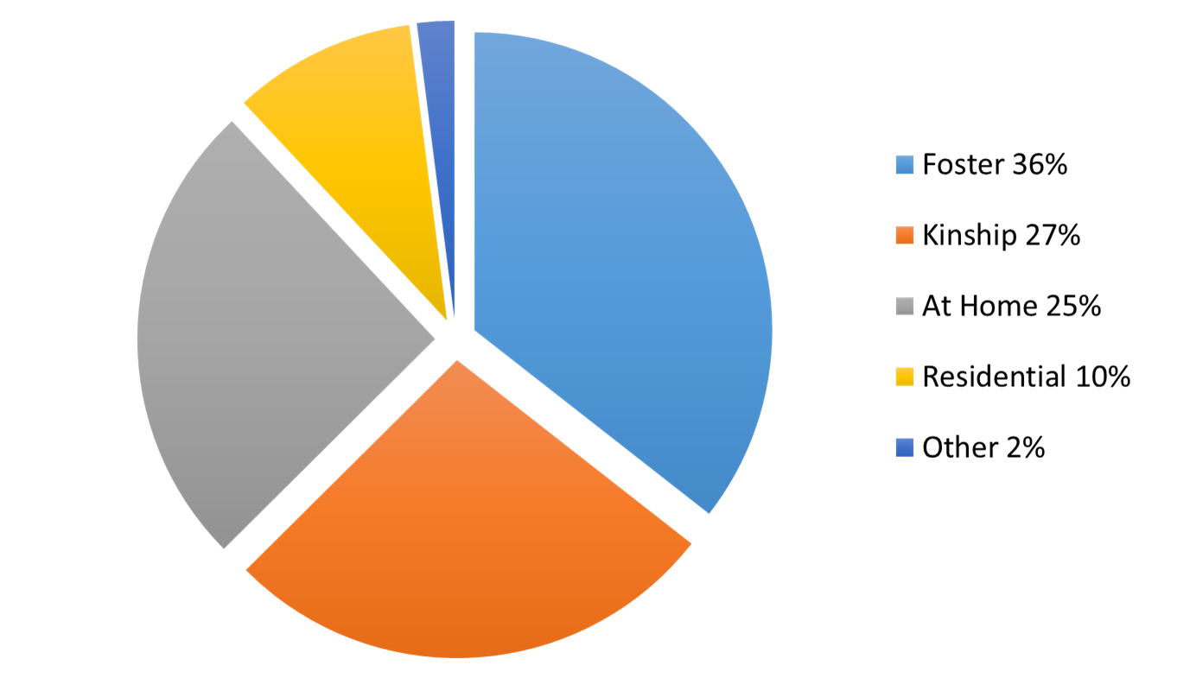
Where is care delivered?

Slide 11
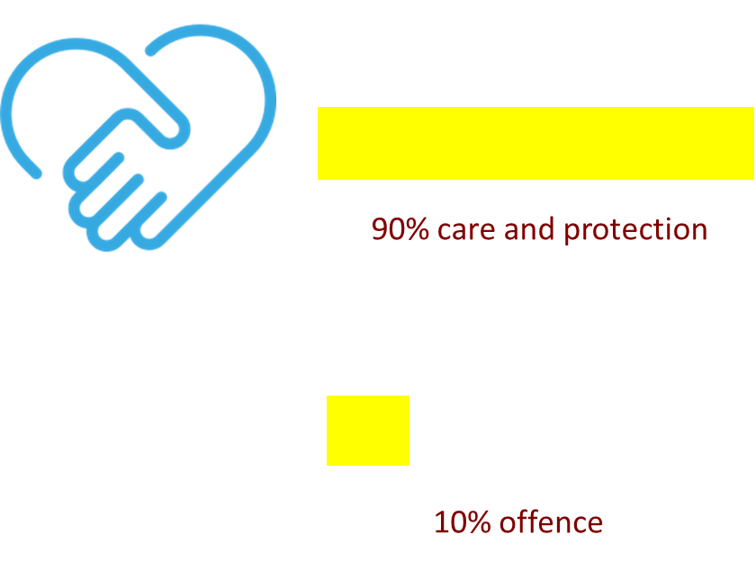
Becoming looked after in Scotland

Slide 12
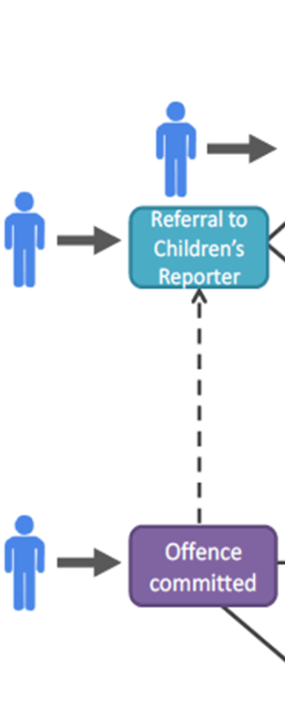
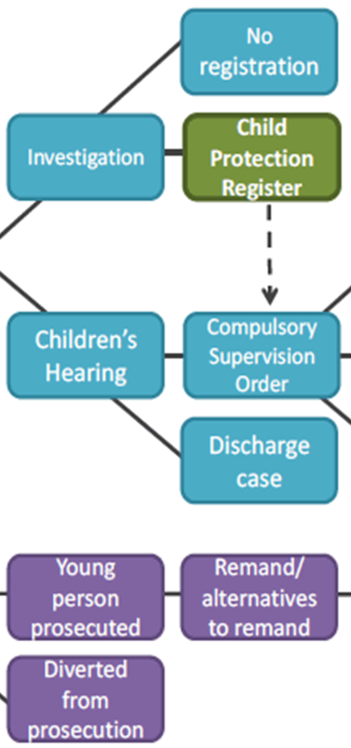
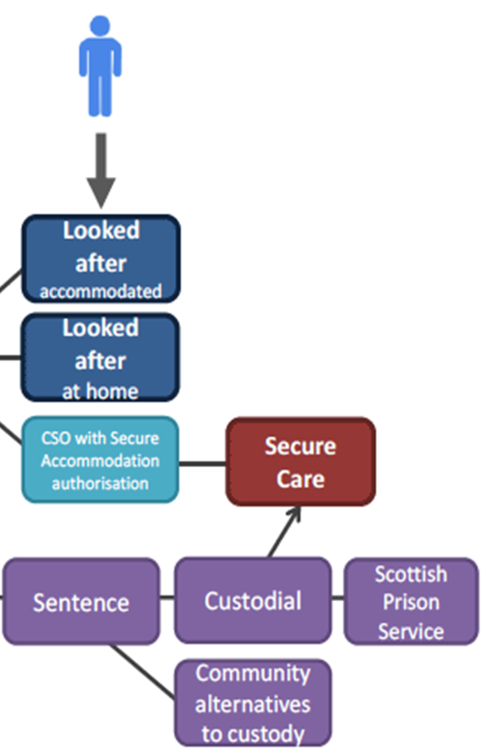
Becoming looked after in Scotland
Notes:
Can you imagine being a child and dealing with the dynamics of all of this

Slide 13
Outcomes
What are the outcomes like for
care experienced people?

Slide 14
Access to University
4%
Scottish Government 2016
Notes:
Its going up from 4% or even 1% as my colleague pointed out yesterday from we first started doing CP training Uni and colleges get hit over the head

Slide 15
School Exclusions
Notes:
Gone down from 10x just 4 years ago

Slide 16
Mental Health
Notes:
Imagine the stigma attached to being in care AND being mentally unwell

Slide 17
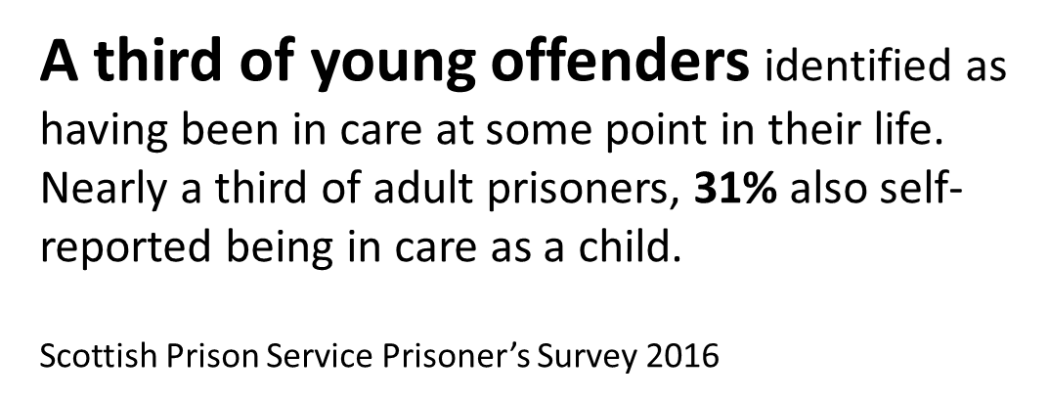
Prison Population
Notes:
Better chance of seeing the inside of a prison that the inside of a university or College classroom

Slide 18
Employment
Notes:
Better chance of seeing the inside of a prison that the inside of a university or College classroom

Slide 19
Premature Death
“establishes a new duty on local authorities to notify Scottish Ministers and the Care Inspectorate of the deaths of care leavers”
Notes:
Better chance of seeing the inside of a prison that the inside of a university or College classroom

Slide 20
Premature Death
Care experienced young people are 20x more likely to die before they are 25 years old
Notes:
Better chance of seeing the inside of a prison that the inside of a university or College classroom

Slide 21
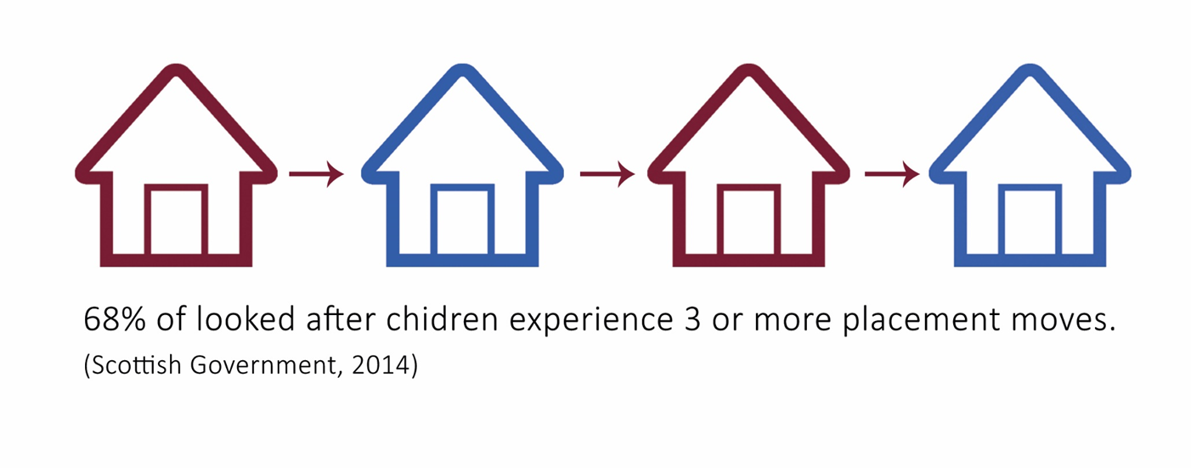
Housing
Notes:
Better chance of seeing the inside of a prison that the inside of a university or College classroom

Slide 22
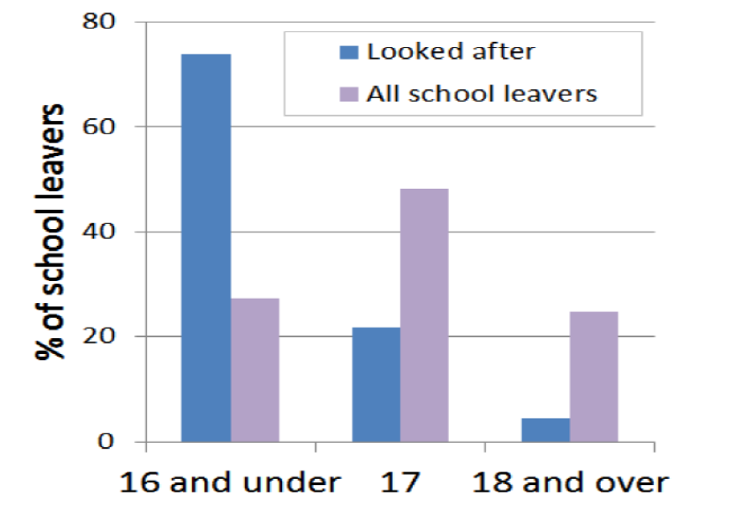
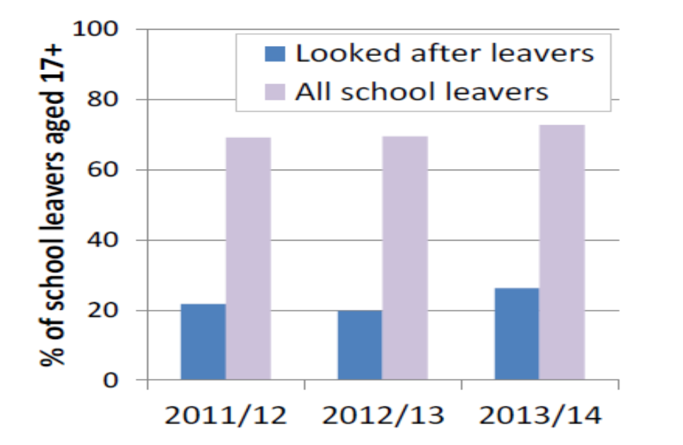
Leaving School
Notes:
Why are they not achieving a place at Uni? Or College

Slide 23
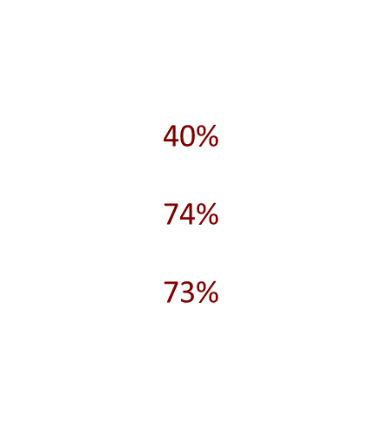
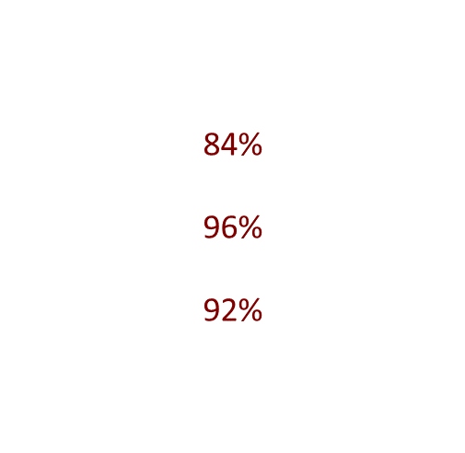
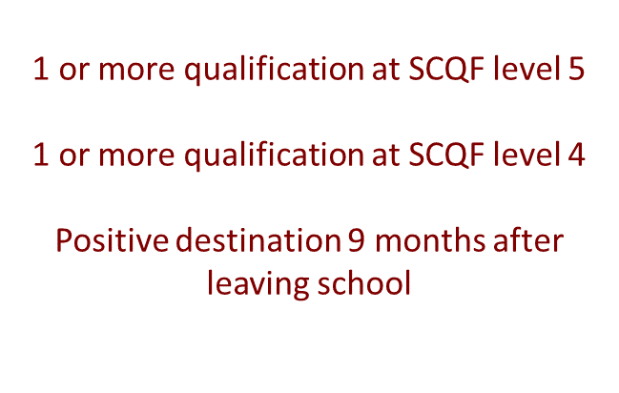
Attainment
Looked after children
Non looked after children

Slide 24
Additional Support
Co-ordinated Support Plan
6,374 have actually been assessed
368 require a Support Plan
0 Appeals
Highland Council 46.7%
East Ayrshire Council 0.7%

Slide 25
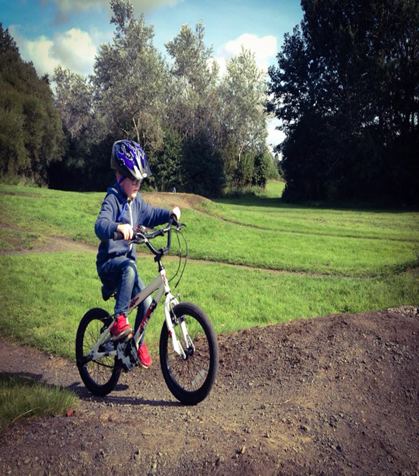
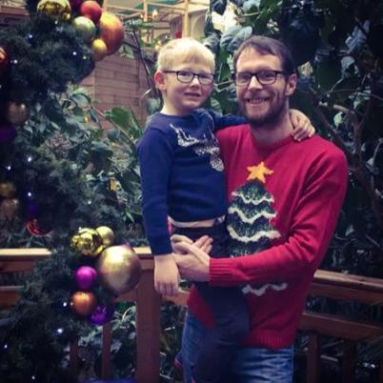
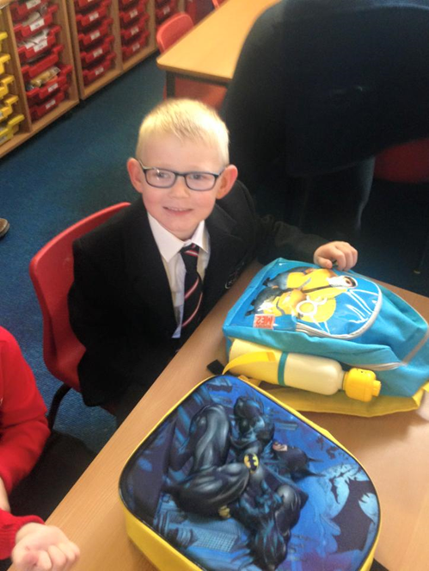
Our Children

Slide 26
Activity
What barriers are there for care experienced people?

Slide 27
My Story
Shilla Shomai

Slide 28
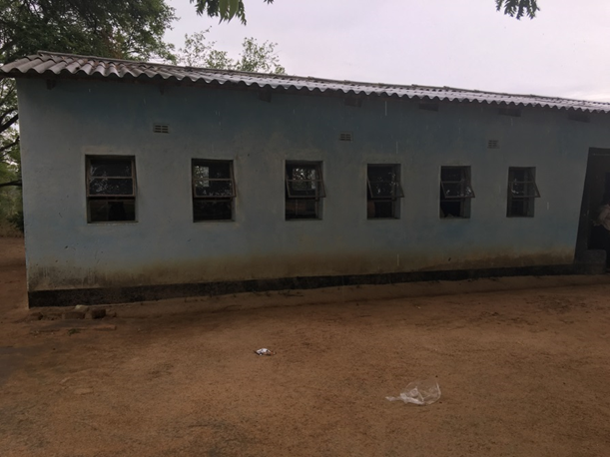
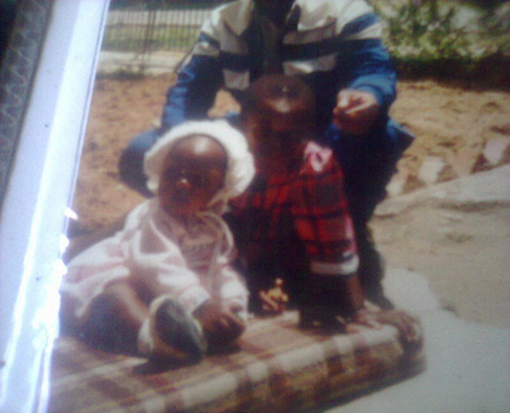
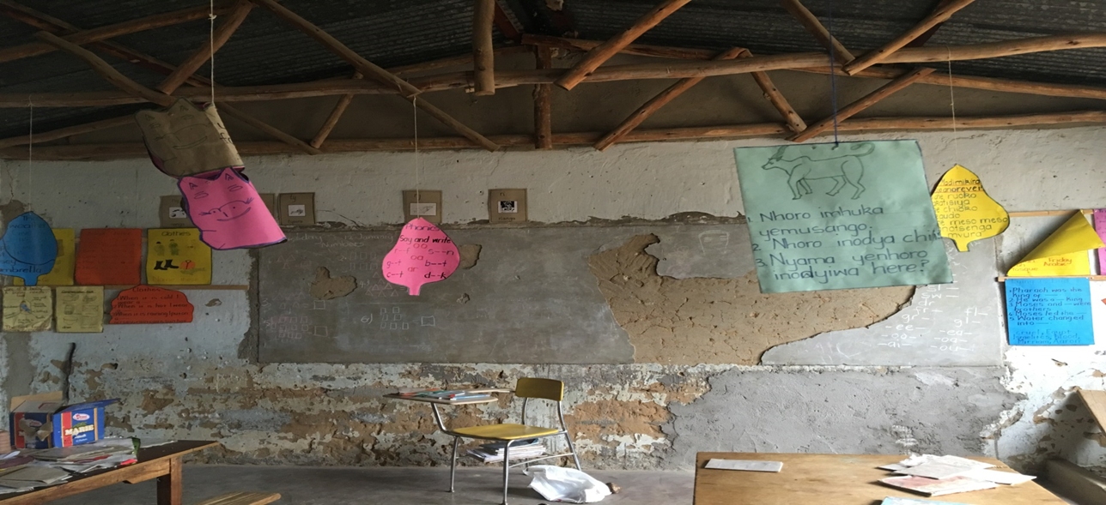
Shilla Shomai

Slide 29
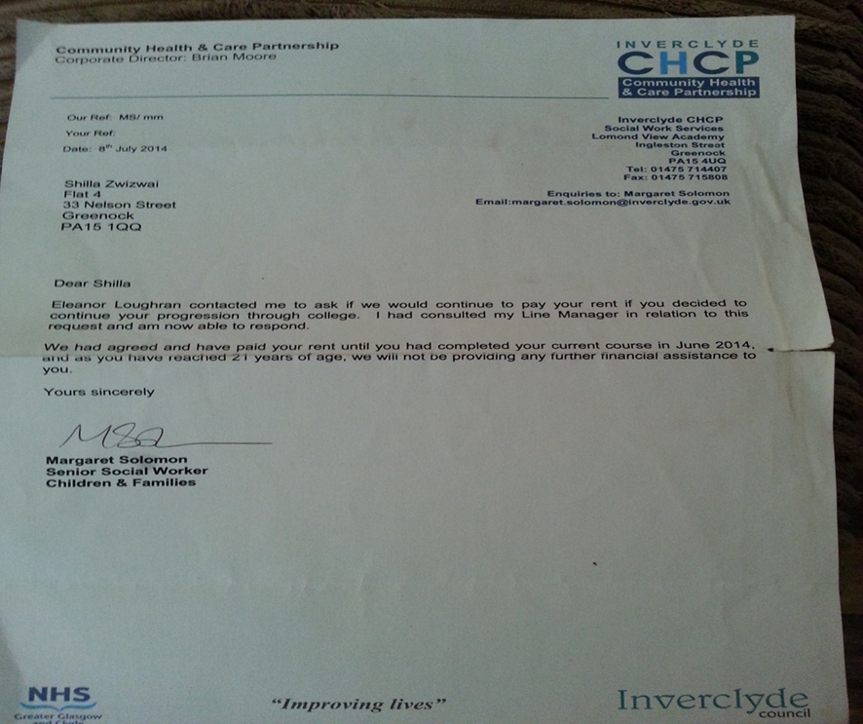
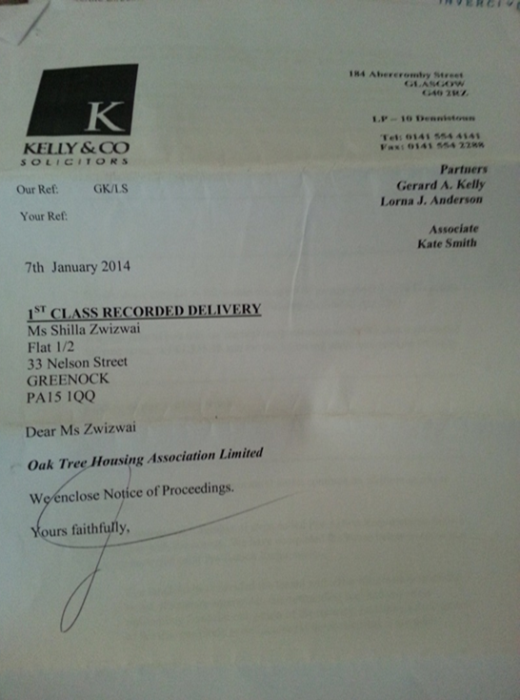
Shilla Shomai

Slide 30
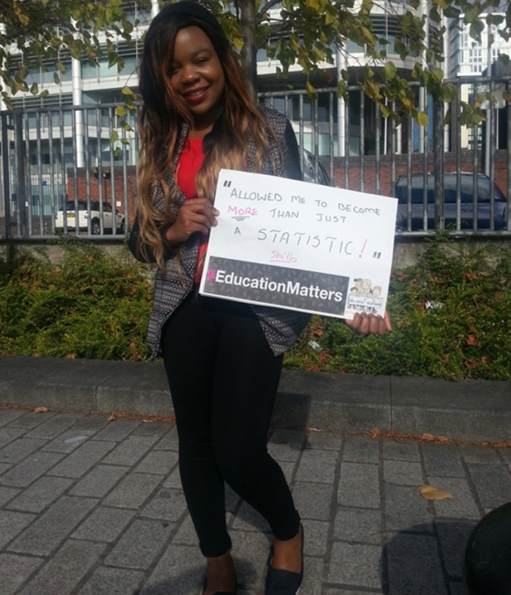
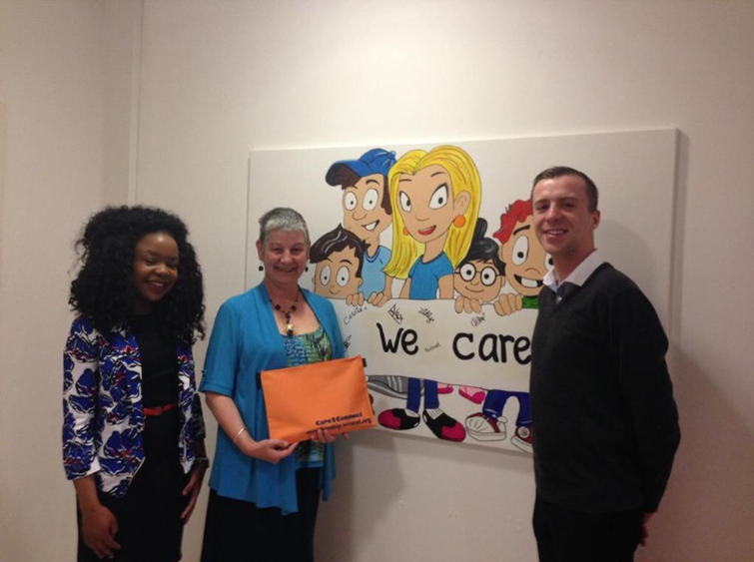
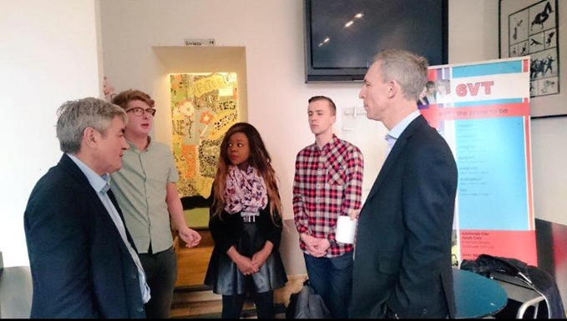
Shilla Shomai

Slide 31
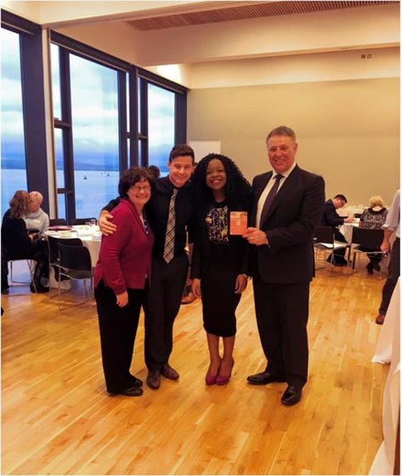
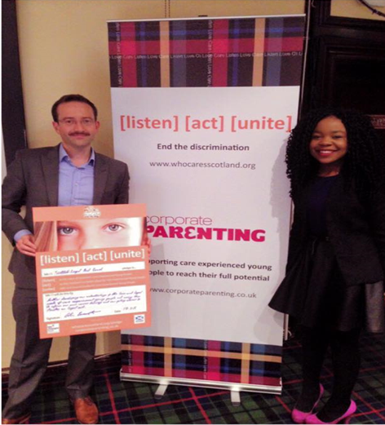
Shilla Shomai

Slide 32
My new Corporate Parent
Shilla Shomai

Slide 33
Collaborate
sharing information
providing advice or assistance
co-ordinating activities
sharing responsibility for action
funding activities jointly
Jointly exercising functions

Slide 34
Not good Corporate Parenting
Not understanding the needs of the young people
Not knowing what support you can offer
Not knowing what support others can offer
Not understanding your responsibilities

Slide 35
Good Corporate Parenting
Not box ticking
Collaborating not delegating
Caring and sharing
Providing opportunities

Slide 36
Any Questions?

Slide 37
National Care Leavers Week 2016
20th-28th October

Slide 38
Thank You
www.corporateparenting.co.uk
www.whocaresscotland.org
Robert Foster
Corporate Parenting Officer FE/HE
rfoster@whocaresscotland.org

